Slide 1
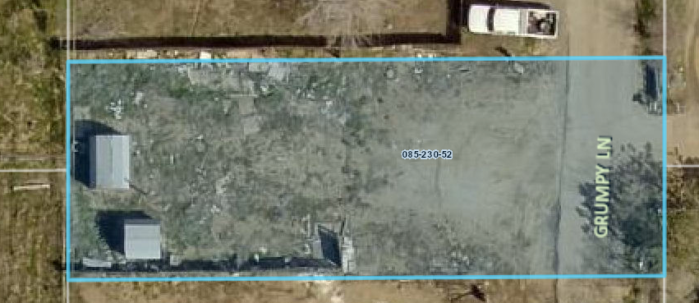
Special Use Permit WSUP19-0010
Washoe County
Board of Adjustment
June 6, 2018
Bell Residence

Slide 2
Overview of Request
Replace a manufactured home (original already removed)
Residential uses require Special Use Permit in Neighborhood Commercial (NC) regulatory zone
WMPA18-0001/WDCA18-0001 initiated to allow single-family dwelling in NC

Slide 3
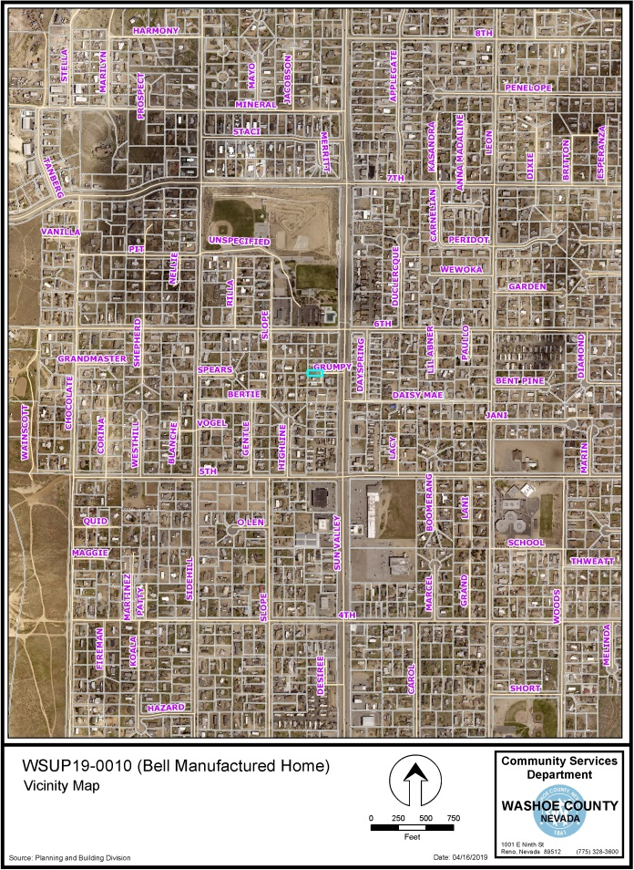
Vicinity Map
109 Grumpy Ln
Neighborhood Commercial (NC)
±0.16-acres
Within the Downtown Character Management Area of the Sun Valley Area Plan
Subject Property

Slide 4
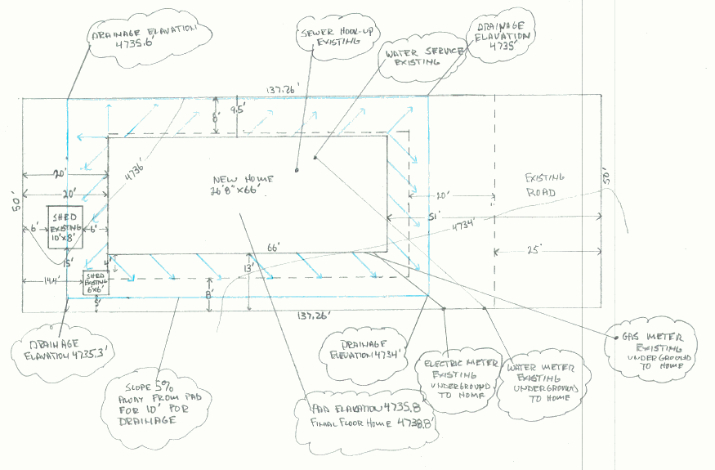
Site Plan

Slide 5
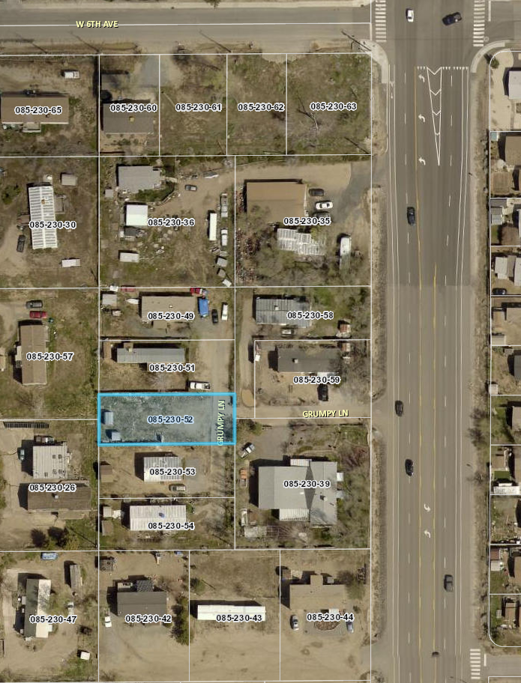
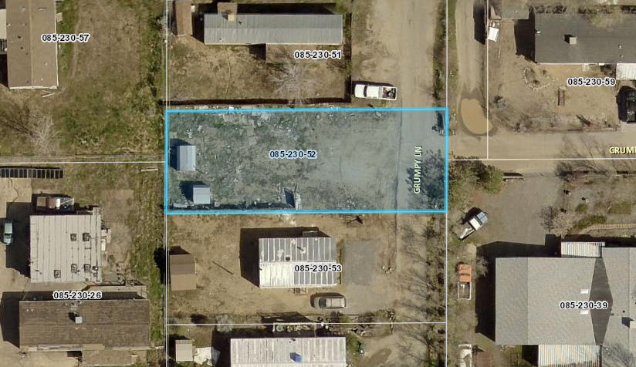
Aerial Photo

Slide 6
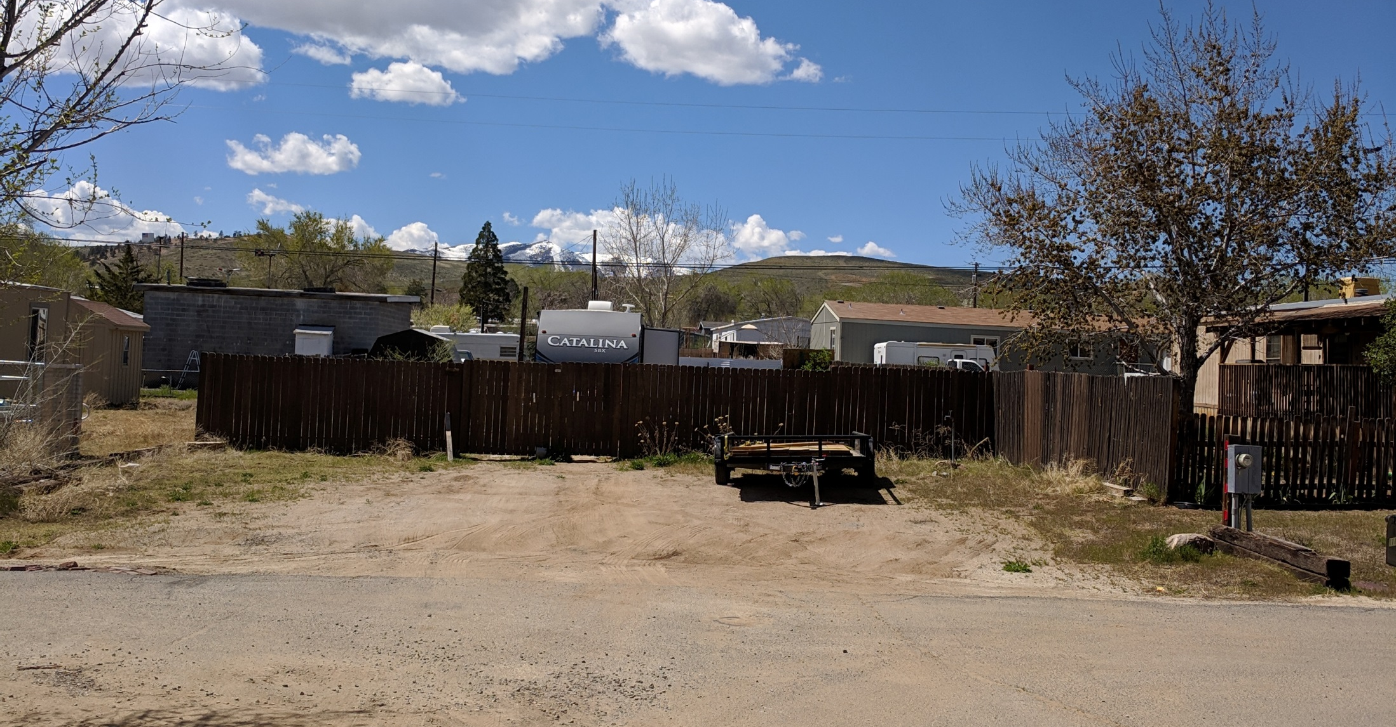
Site Photo

Slide 7
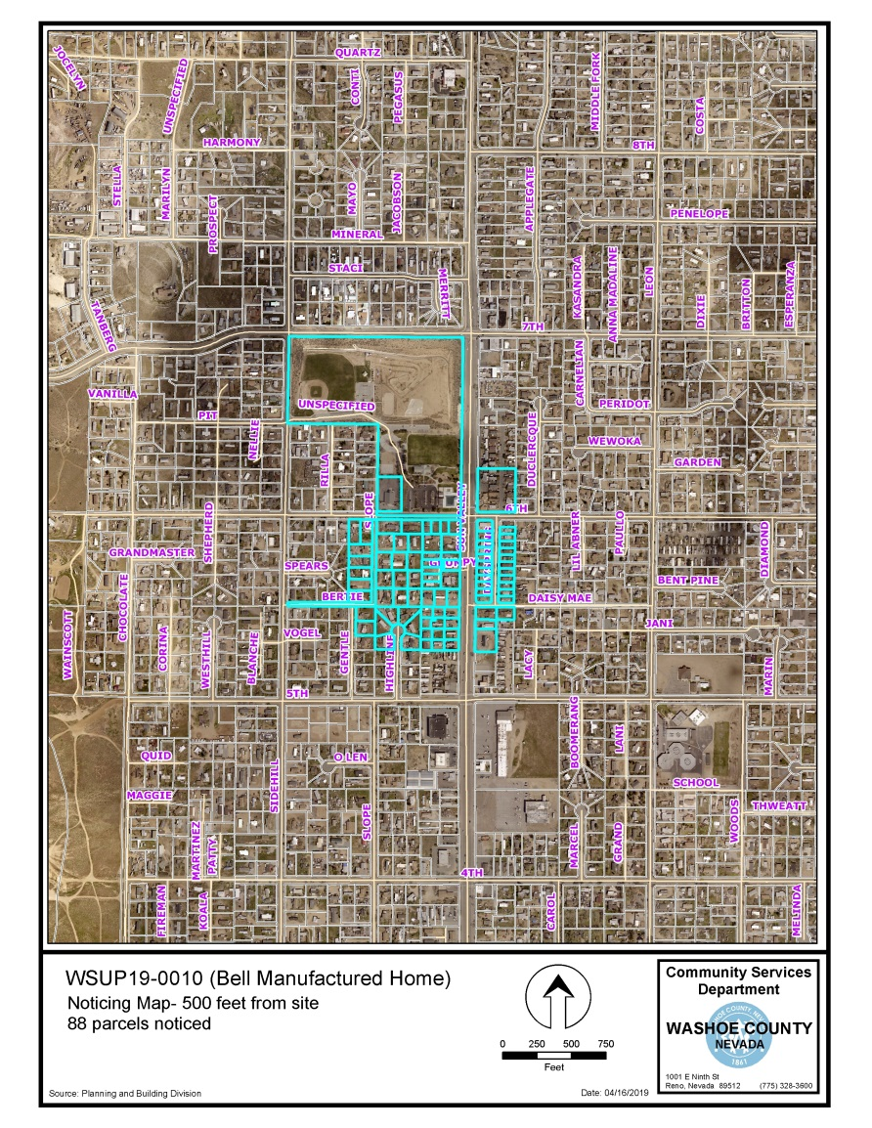
Public Notice

Slide 8
Citizen Advisory Board (CAB)
Sun Valley CAB did not meet during review period
Worksheet sent, no comments returned
No public comments

Slide 9
Reviewing Agencies
Washoe County Community Services Department
  Planning and Building
  Engineering and Capital Projects
  Utilities/Water Rights
Truckee Meadows Fire Protection District
Washoe County Health District
Regional Transportation Commission
Sun Valley General Improvement District
Washoe-Storey Conservation District

Slide 10
Recommended Conditions
Standard conditions for lighting, landscaping, parking, screening
Sun Valley GID inspections
Compliance with Sun Valley Area Plan policies and building code
Demonstrate that sufficient water rights are available for the dwelling

Slide 11
Required Findings
Consistency
Improvements
Site Suitability
Issuance not Detrimental
Recommendation: Approval with conditions

Slide 12
Possible Motion
I move that, after giving reasoned consideration to the information contained in the staff report and received during the public hearing, the Board of Adjustment approve, with conditions, Administrative Permit Case Number WADMIN19-0010 for Ron Bell, having made all four findings in accordance with Washoe County Code Section 110.808.25.

